Slide 1
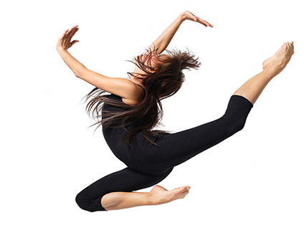
LESSON 8
YEAR 9 DANCE
DANCE SKILLS UNIT .

Slide 2

LONG TERM OBJECTIVES
explore and develop your dance skills and review your own practice
use your dance skills within rehearsal and performance.

Slide 3
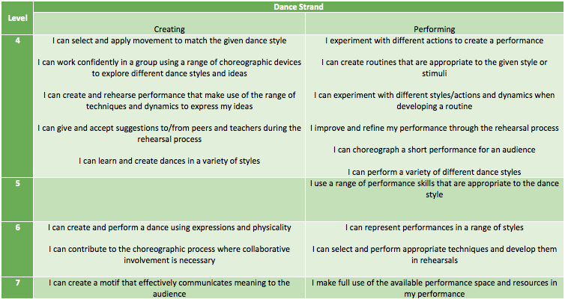
SUCCESS CRITERIA

Slide 4
DANCE EVALUATION
WATCH YOUR VIDEO BACK OF YOUR PERFORMANCE.
COMPLETE YOUR ASSESSMENT SHEET EVALUATING THE FOLLOWING ABOUT YOUR PERFORMACE:
Performance skills
Movement memory
Musicality
Fluidity of movement

